Slide 1
Conditional Probability

Slide 2
Conditional Probability
The conditional probability of an event B is the probability that the event will occur - given the knowledge that an event A has already occurred.
This probability is written as P(B|A), i.e. notation for the probability of B given A.
*In such cases where events A and B are independent (where event A has no effect on the probability of event B), the conditional probability of event B given event A is simply the probability of event B, that is P(B).

Slide 3
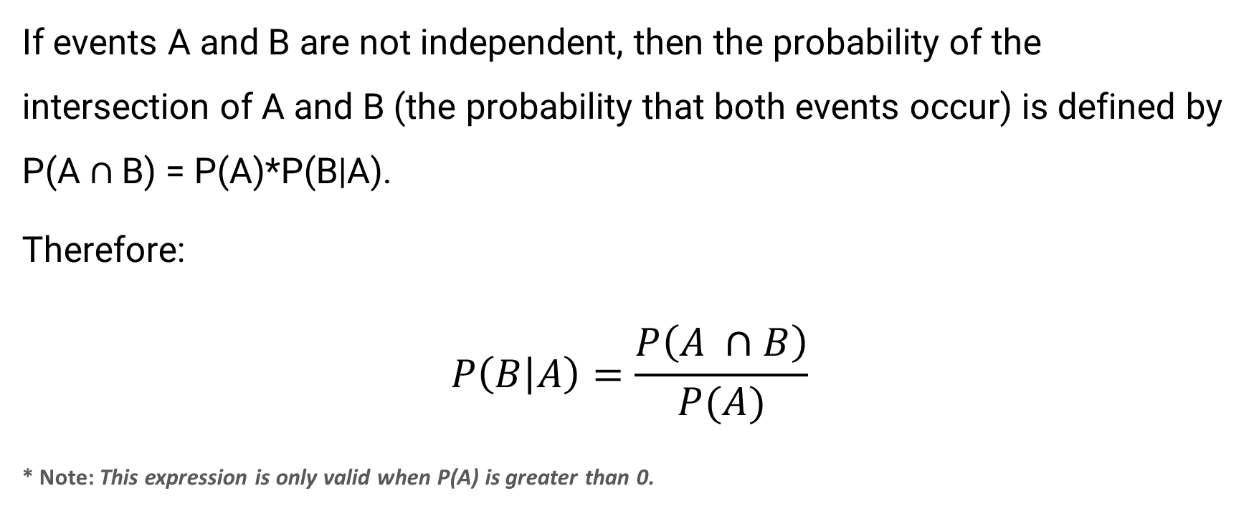
Conditional Probability (Continued)
If events A and B are not independent, then the probability of the intersection of A and B (the probability that both events occur) is defined by P(A $∩$B) = P(A)*P(B|A).
Therefore:
$$P\left(B | A\right)=\frac{P\left(A ∩B\right)}{P(A)}$$
* Note: This expression is only valid when P(A) is greater than 0.

Slide 4
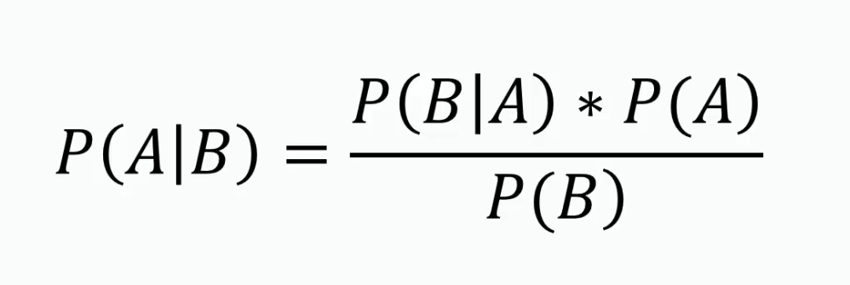
Bayes’ Theorem
Bayes’ theorem is a way to figure out conditional probability. Conditional probability is the probability of an event happening, given that it has some relationship to one or more other events. For example, your probability of getting a parking space is connected to the time of day you park, where you park, and what conventions are going on at any time. Bayes’ theorem is slightly more nuanced. In a nutshell, it gives you the actual probability of an event given information about tests.

Slide 5
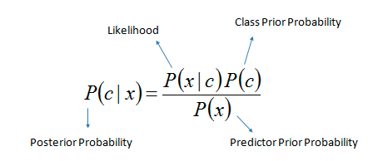

Slide 6
Examples
In a card game, suppose a player needs to draw two cards of the same suit in order to win.
Of the 52 cards, there are 13 cards in each suit. Suppose first the player draws a heart. Now the player wishes to draw a second heart. Since one heart has already been chosen, there are now 12 hearts remaining in a deck of 51 cards.
So the conditional probability P(Draw second Heart|First card a Heart) = 12/51.

Slide 7
Examples
Suppose an individual applying to a college determines that he has an 80% chance of being accepted, and he knows that dormitory housing will only be provided for 60% of all of the accepted students.
The chance of the student being accepted and receiving dormitory housing is defined by:
P(Accepted and Dormitory Housing) = P(Dormitory Housing|Accepted) * P(Accepted)
= (0.60)*(0.80) = 0.48.

Slide 8
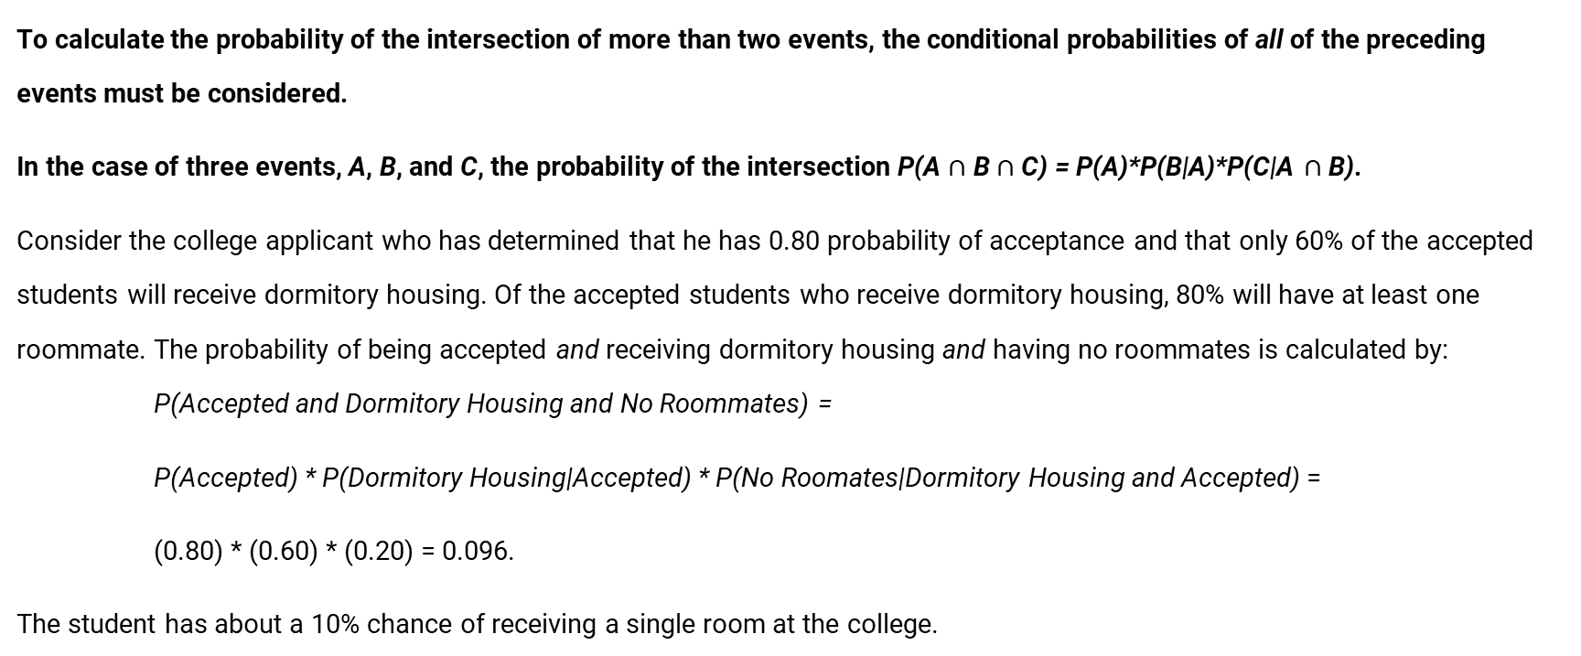
When there are more than 2 events
To calculate the probability of the intersection of more than two events, the conditional probabilities of all of the preceding events must be considered.
In the case of three events, A, B, and C, the probability of the intersection P(A $∩$ B $∩$ C) = P(A)*P(B|A)*P(C|A $∩$ B).
Consider the college applicant who has determined that he has 0.80 probability of acceptance and that only 60% of the accepted students will receive dormitory housing. Of the accepted students who receive dormitory housing, 80% will have at least one roommate. The probability of being accepted and receiving dormitory housing and having no roommates is calculated by: P(Accepted and Dormitory Housing and No Roommates) =
P(Accepted) * P(Dormitory Housing|Accepted) * P(No Roomates|Dormitory Housing and Accepted) =
(0.80) * (0.60) * (0.20) = 0.096.
The student has about a 10% chance of receiving a single room at the college.

Slide 9

Likelihood
Here, X represents the attributes or features, and Y is the response variable. Now, P(X|Y) becomes equal to the products of, probability distribution of each attribute X given Y.

Slide 10
Probability vs. Likelihood
Understanding the statistical meaning of Probability and Likelihood

Slide 11


Suppose you have a probability model with parameters θ. p(x | θ) has two names.
It can be called the probability of x (given θ), or the likelihood of θ (given that x was observed).
The likelihood is a function of θ.

Slide 12

Maximum Likelihood Estimation
For P(x| θ)
If you observe x and want to estimate the θ that gave rise to it, the Maximum Likelihood principle says to choose the maximum-likelihood θ -- in other words, the θ that maximizes p(x | θ).

Slide 13

Maximum a-posteriori Estimate (MAP)
Maximum Likelihood Estimation contrasts with the Maximum a-posteriori or MAP estimate, which is the θ that maximizes p(θ | x). Since x is fixed, this is equivalent to maximizing p(θ) p(x | θ), the product of the prior probability of θ with the likelihood of θ.

Slide 14
Further Explanation
Probability vs. Likelihood

Slide 15
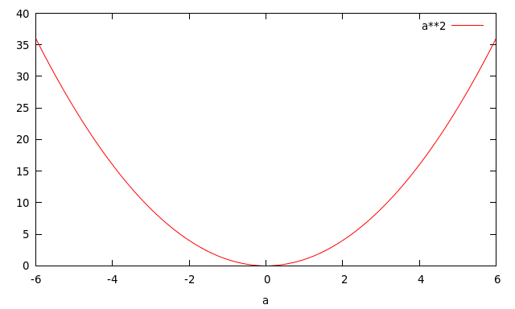

Consider the function $a^{b}$ (a to the power b). This is a function of two variables.
If you set b=2, then you get the quadratic function $a^{2}$ (function of a):

Slide 16
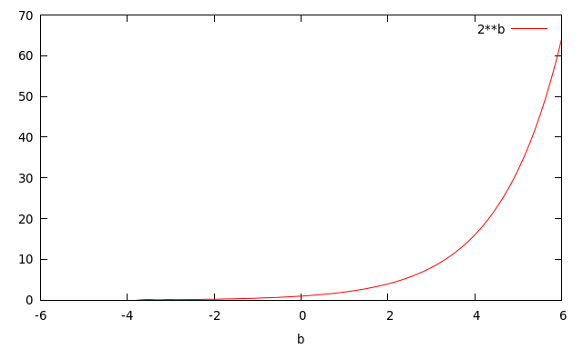

Whereas if you set a=2, you get the exponential function $2^{b}$ (function of b):

Slide 17
Similarly, p(x | θ) is a function of two variables.
If you hold θ constant, you get the Probability function (function of x),
If you hold x constant, you get the Likelihood function (function of θ).

